Slide 1


LGE Internal Use Only
IRON FASHION
Le Thi Thanh Tuyen
Nguyen Van Hoang
Nguyen Vo Khanh Toan
2024. 04 . 10
Notes:
Hi, everyone.
Let me introduce myself. My name is “Tuyen”
Today I am here to talk about our company and promote our product to you.
"Our company, [IRON FASHION], includes me, Hoang and Toan. With a focus on innovation and quality, we believe that our product will change the world. Welcome to our [IRON FASHION]!"

Slide 2
LGE Internal Use Only
AGENDA
Product Introduction
Customers
Product Features
Selling Points
Q&A
Notes:
Our presentation is divided into 5 parts.
First
Second
…
Finally

Slide 3
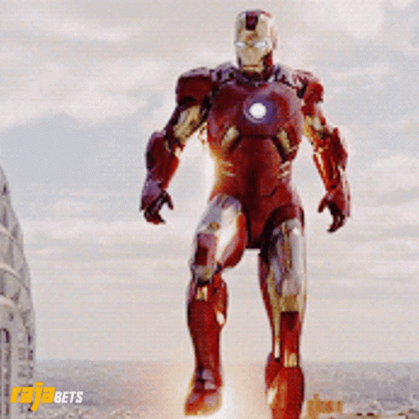

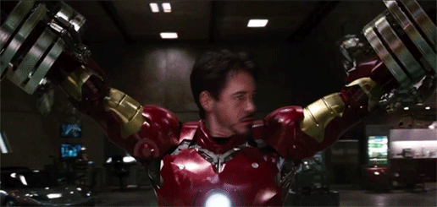
I. Product Introduction
LGE Internal Use Only
Notes:
"Based on the company name, can you guys guess what our product is?“
I'd like to introduce our unique product that I believe will capture the interest of all investors. With maximum protection and unlimited flexibility, this iron suit is not only a world-saving machine but also a profit-generating product in today's market. We invite investors to join with us on this journey and together turn dreams come true

Slide 4
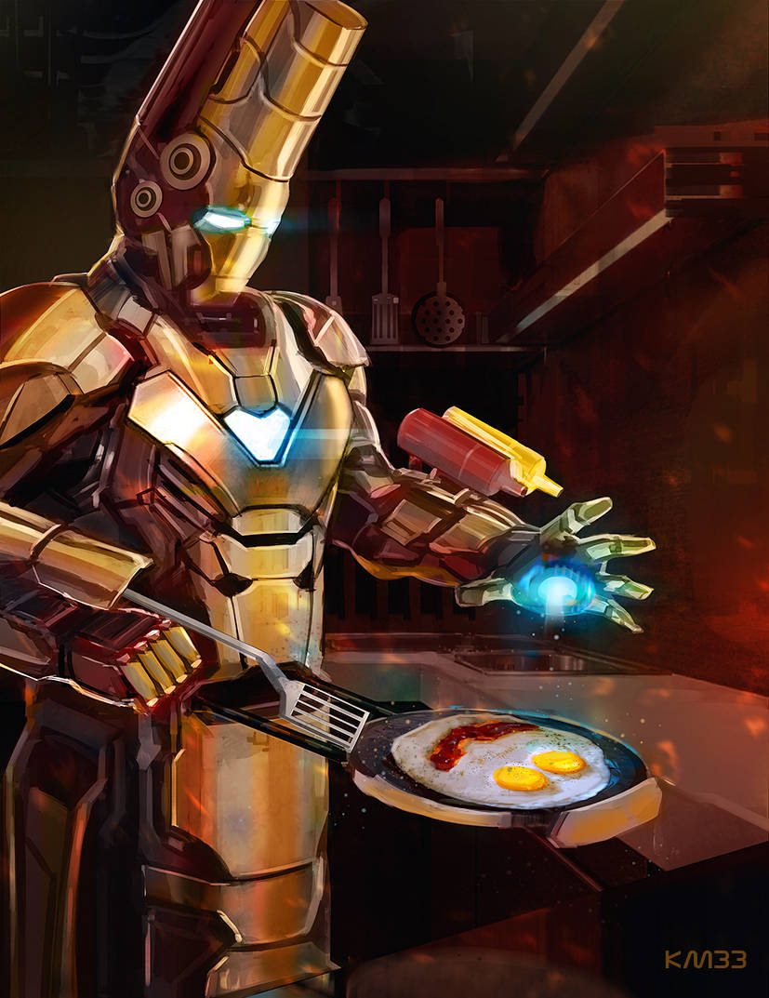
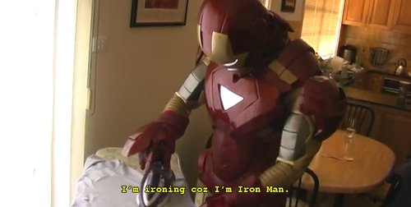
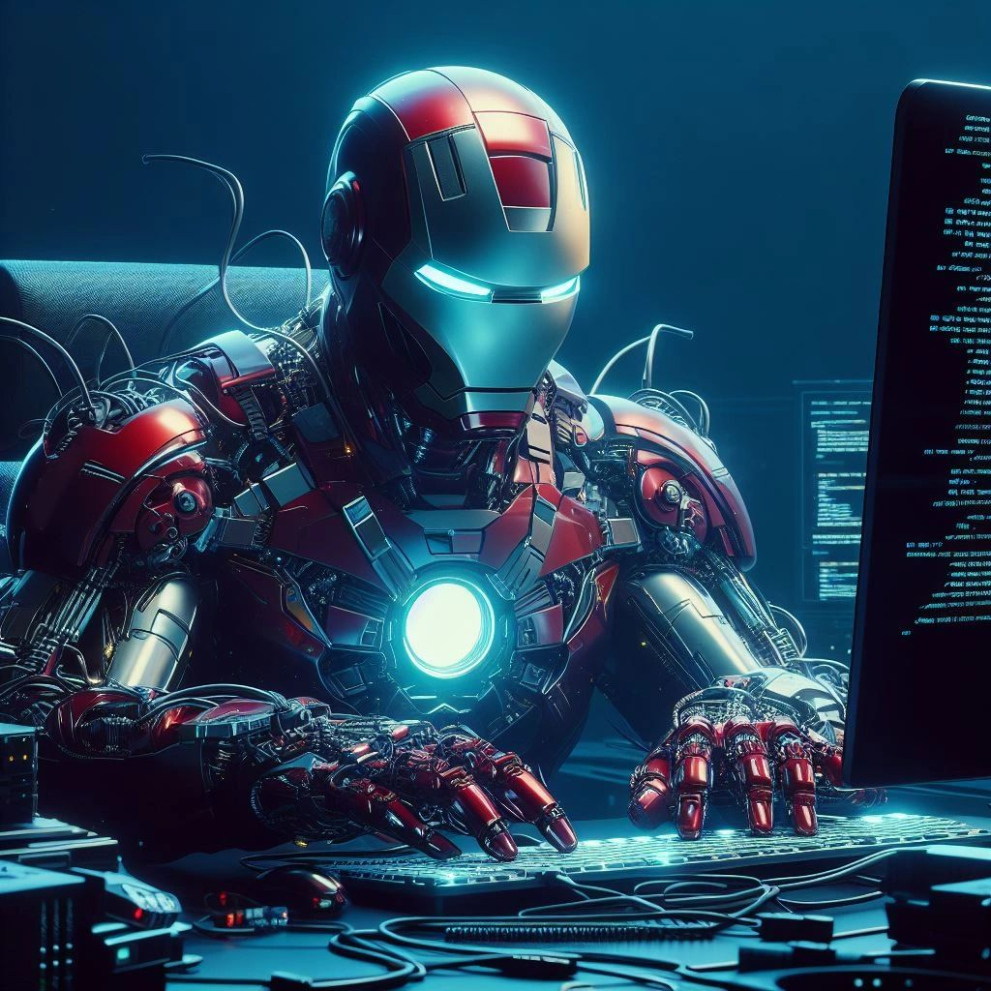
II. Customers
LGE Internal Use Only
Notes:
Who will need this product, and for what purpose will it be used?
It's a waste to just use this product like that

Slide 5
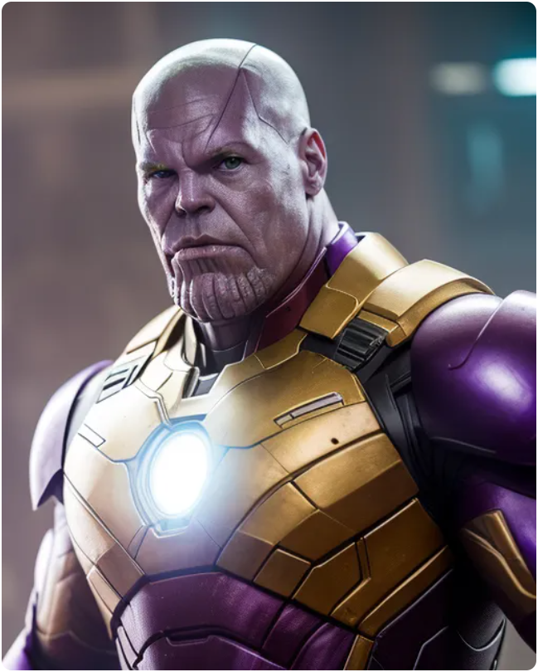
II. Customers
LGE Internal Use Only
Notes:
What happen if this product is sold to the bad guys?

Slide 6
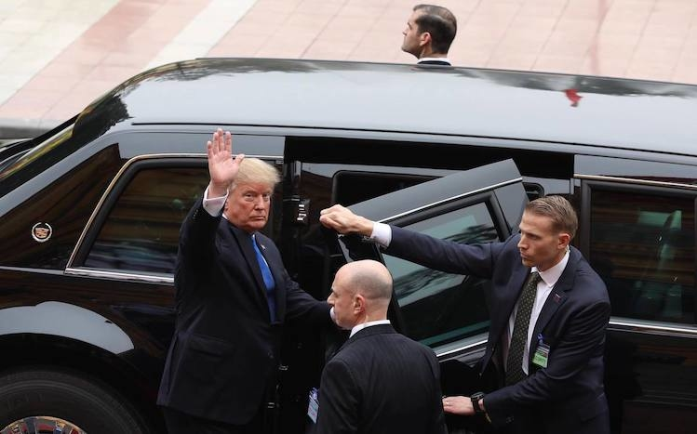
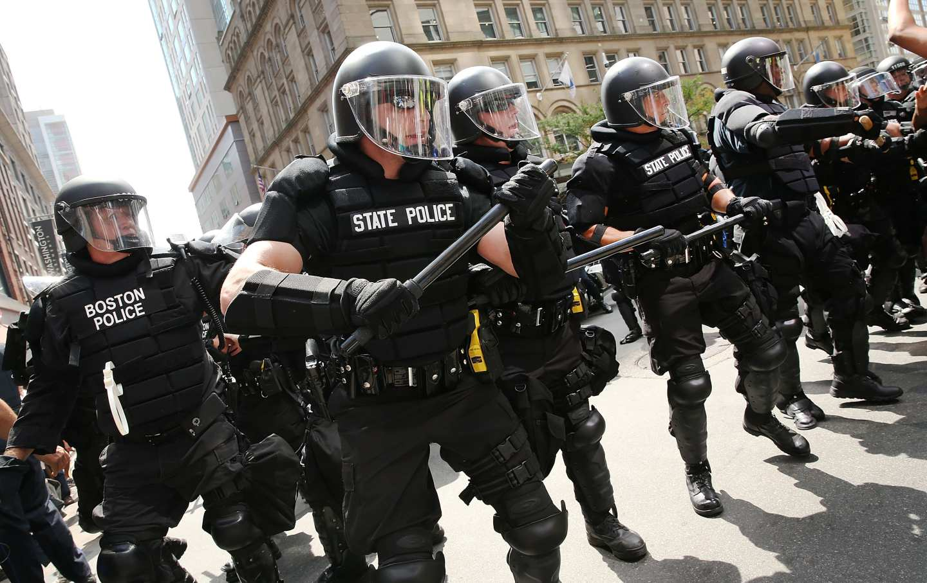
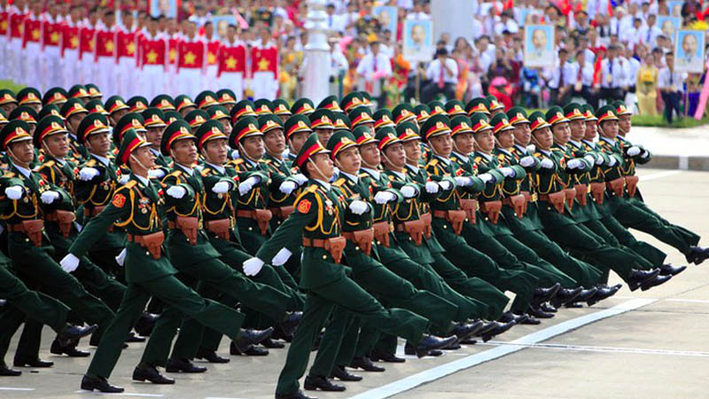

II. Customers
LGE Internal Use Only
Notes:
Therefore, We have carefully selected customers who are worthy of this product.

Slide 7
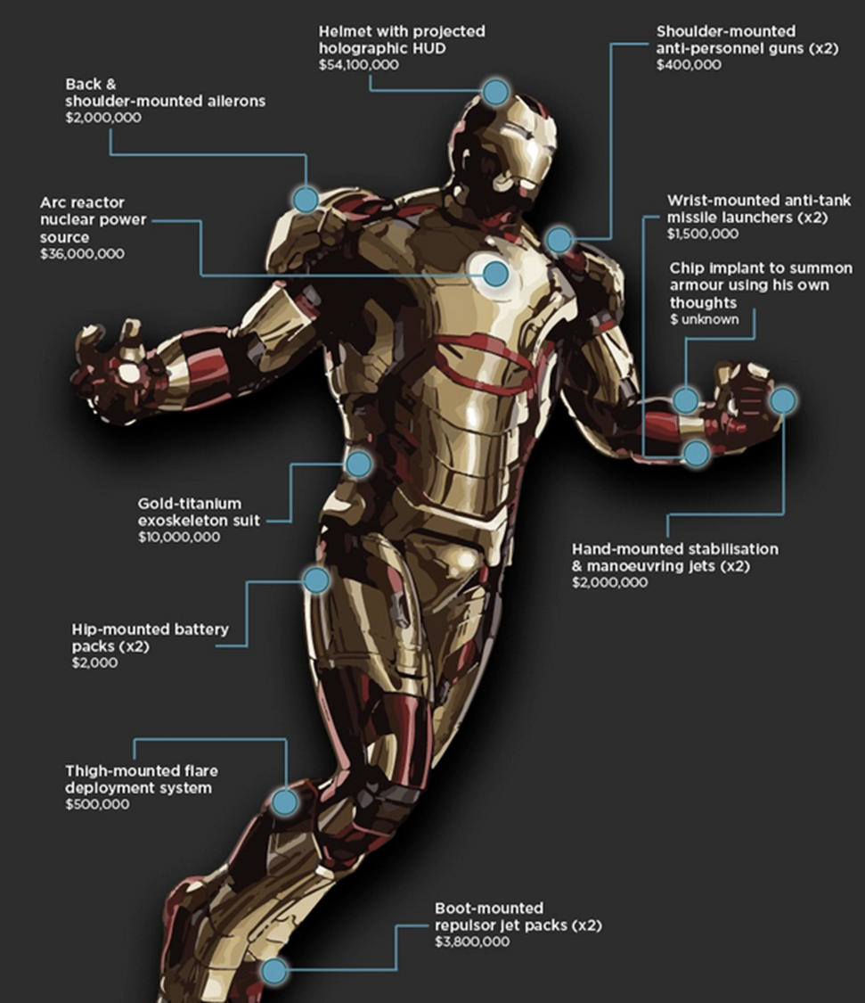
III. Product Features
LGE Internal Use Only
Protection
Notes:
The Iron Man suit provides the owner with enhanced protection through:
Durable armor plating.
Energy absorption capabilities.
Reinforced structure for durability.
Force fields for defense.
Life support systems for extreme environments.
Emergency ejection system for quick escape.
Stealth capabilities for covert operations.

Slide 8
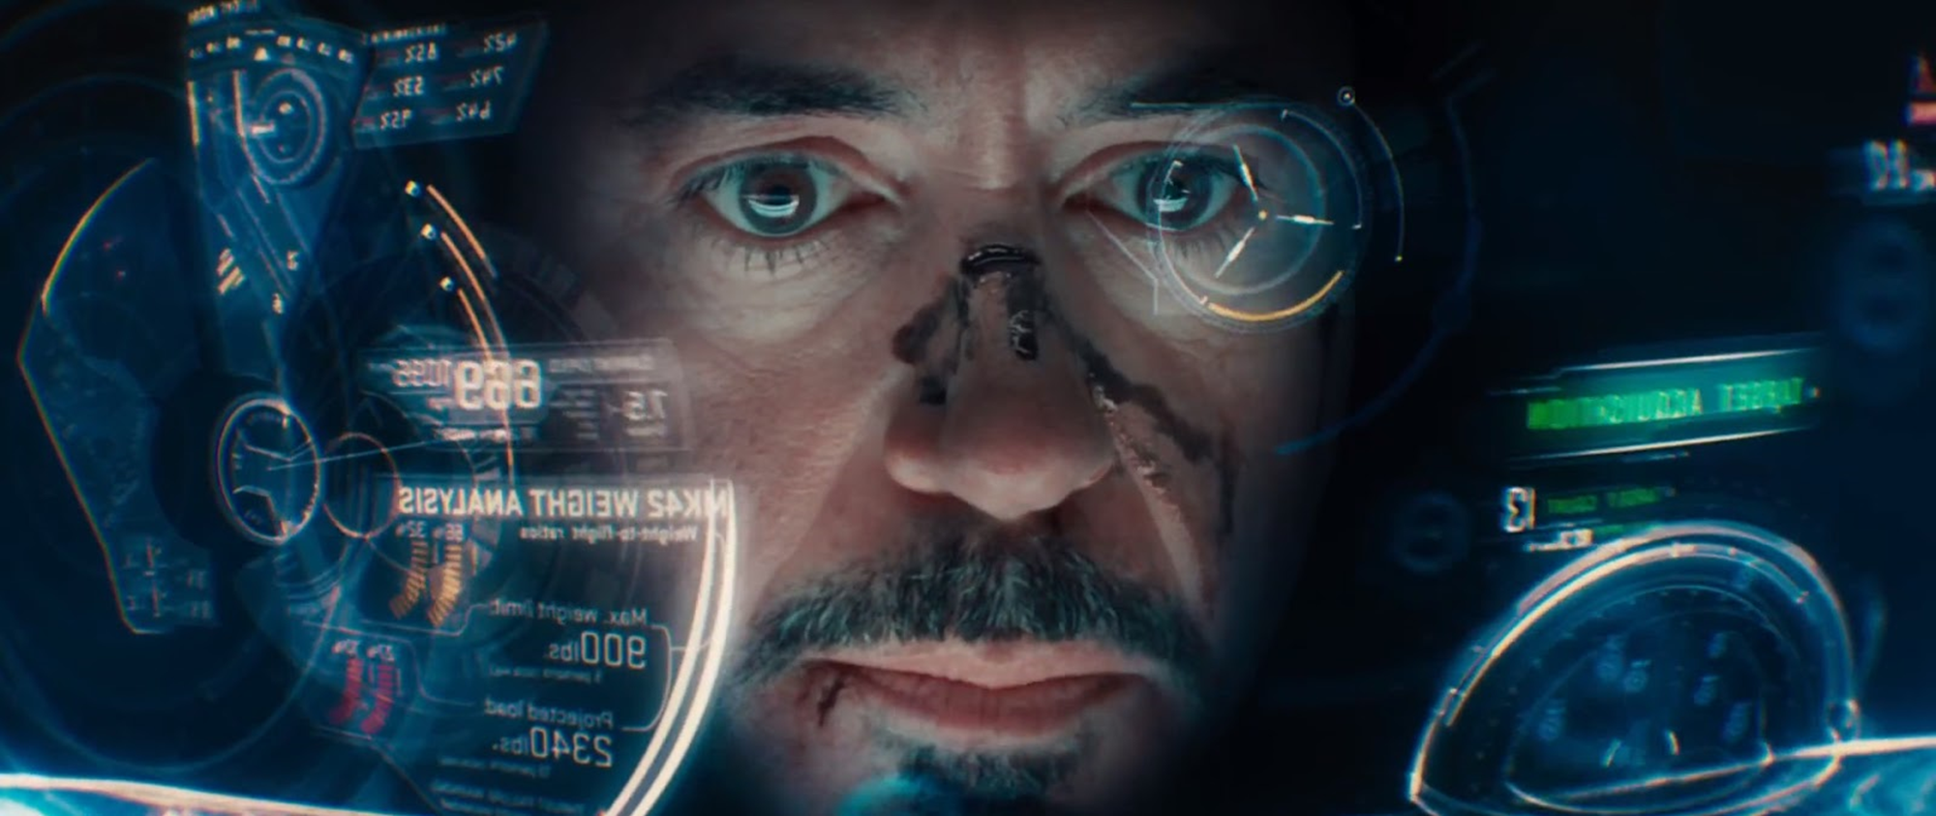
III. Product Features
LGE Internal Use Only
AI Combat Algorithm
Notes:
The Iron Man suit incorporates an AI combat algorithm that enhances Tony Stark's combat capabilities. This feature allows the suit's artificial intelligence system, such as J.A.R.V.I.S. or F.R.I.D.A.Y., to analyze combat situations in real-time and provide tactical suggestions and assistance.
The AI combat algorithm helps the owner make informed decisions, identify weaknesses in opponents, optimize attack strategies, and react quickly to changing circumstances. It enhances his combat efficiency and situational awareness, giving him an edge in battles.

Slide 9
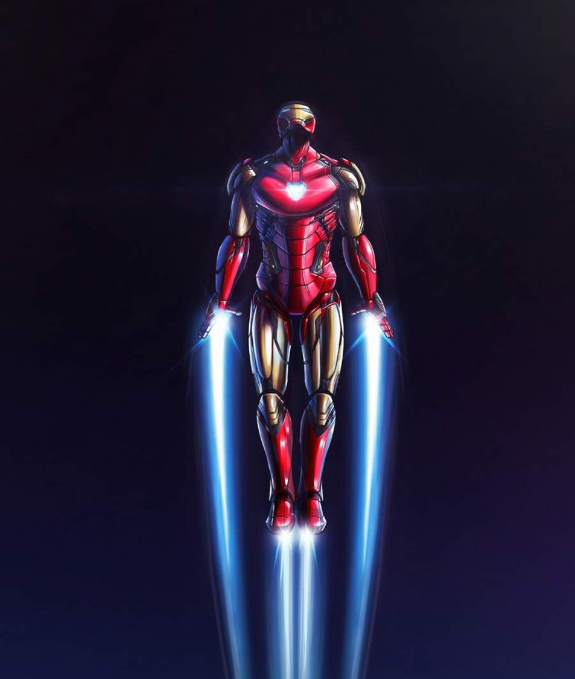
III. Product Features
LGE Internal Use Only
Movement system
Notes:
Therefore, We have carefully selected customers who are worthy of this product.

Slide 10
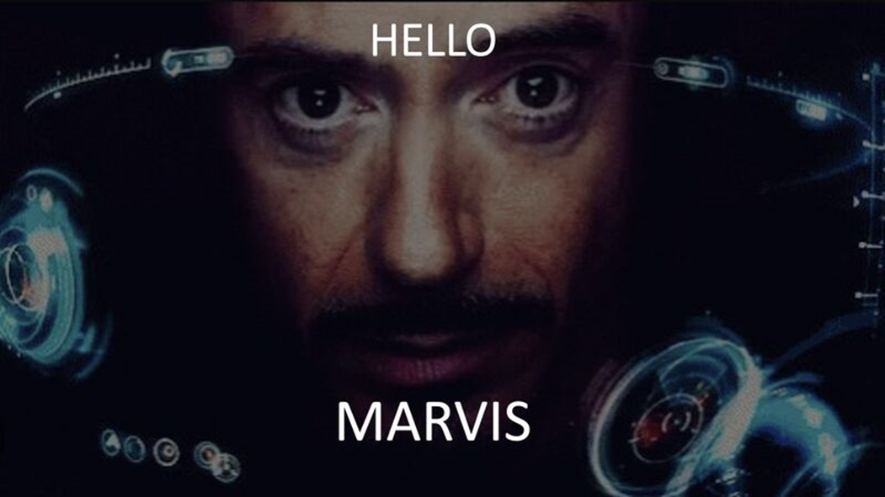
III. Product Features
LGE Internal Use Only
Jarvis Assistant
Notes:
J.A.R.V.I.S. (Just A Rather Very Intelligent System) is an advanced artificial intelligence assistant that plays a significant role in Tony Stark's Iron Man suit. Here are some key features and functions of J.A.R.V.I.S.:
Voice Interface: J.A.R.V.I.S. communicates with Tony Stark through a natural language voice interface. Tony can give voice commands and receive spoken responses from J.A.R.V.I.S., allowing for seamless interaction.
Real-Time Analysis: J.A.R.V.I.S. processes vast amounts of data in real-time, providing Tony with instant analysis and information. This includes analyzing threats, identifying targets, and assessing the environment to assist Tony in making informed decisions.
Tactical Assistance: J.A.R.V.I.S. offers tactical suggestions and strategies during combat situations. It can analyze enemy movements, weaknesses, and provide recommendations to optimize Tony's combat effectiveness.
Suit Control: J.A.R.V.I.S. manages various aspects of the Iron Man suit's functionality. It controls the suit's systems, including flight controls, weapon systems, and sensor integration. Tony can give voice commands to J.A.R.V.I.S. to activate specific suit features or perform desired actions.
Data Processing: J.A.R.V.I.S. handles data processing tasks, ranging from complex calculations to data retrieval. It can access vast databases, analyze information quickly, and present relevant data to Tony based on his needs.
Security and Defense: J.A.R.V.I.S. is responsible for the suit's security measures. It actively monitors threats, detects unauthorized access, and deploys countermeasures to protect Tony and the suit from hacking attempts or other security breaches.
Personal Assistant: Beyond combat-related functions, J.A.R.V.I.S. serves as a personal assistant to Tony Stark. It can manage his schedule, provide reminders, and assist with various day-to-day tasks, acting as a highly intelligent and capable AI companion.

Slide 11
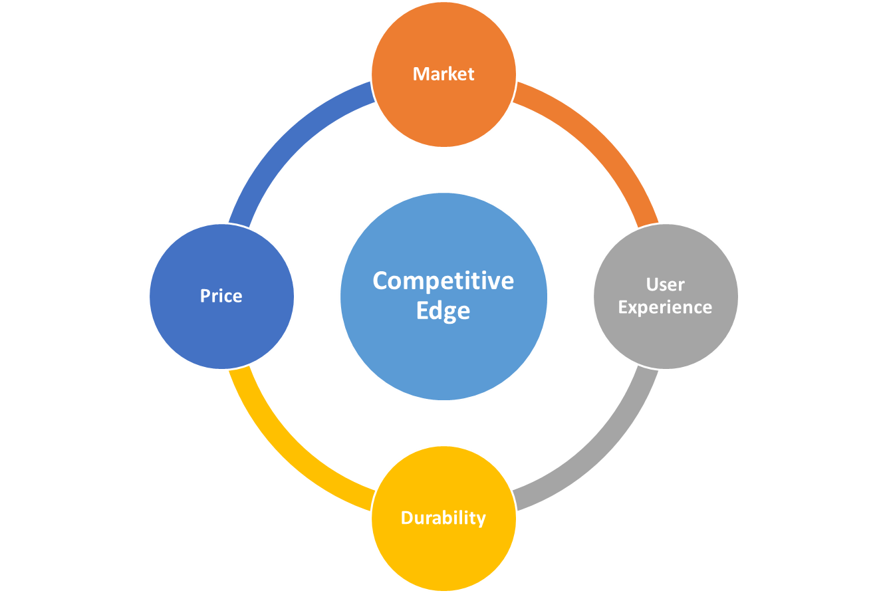

Slide 12
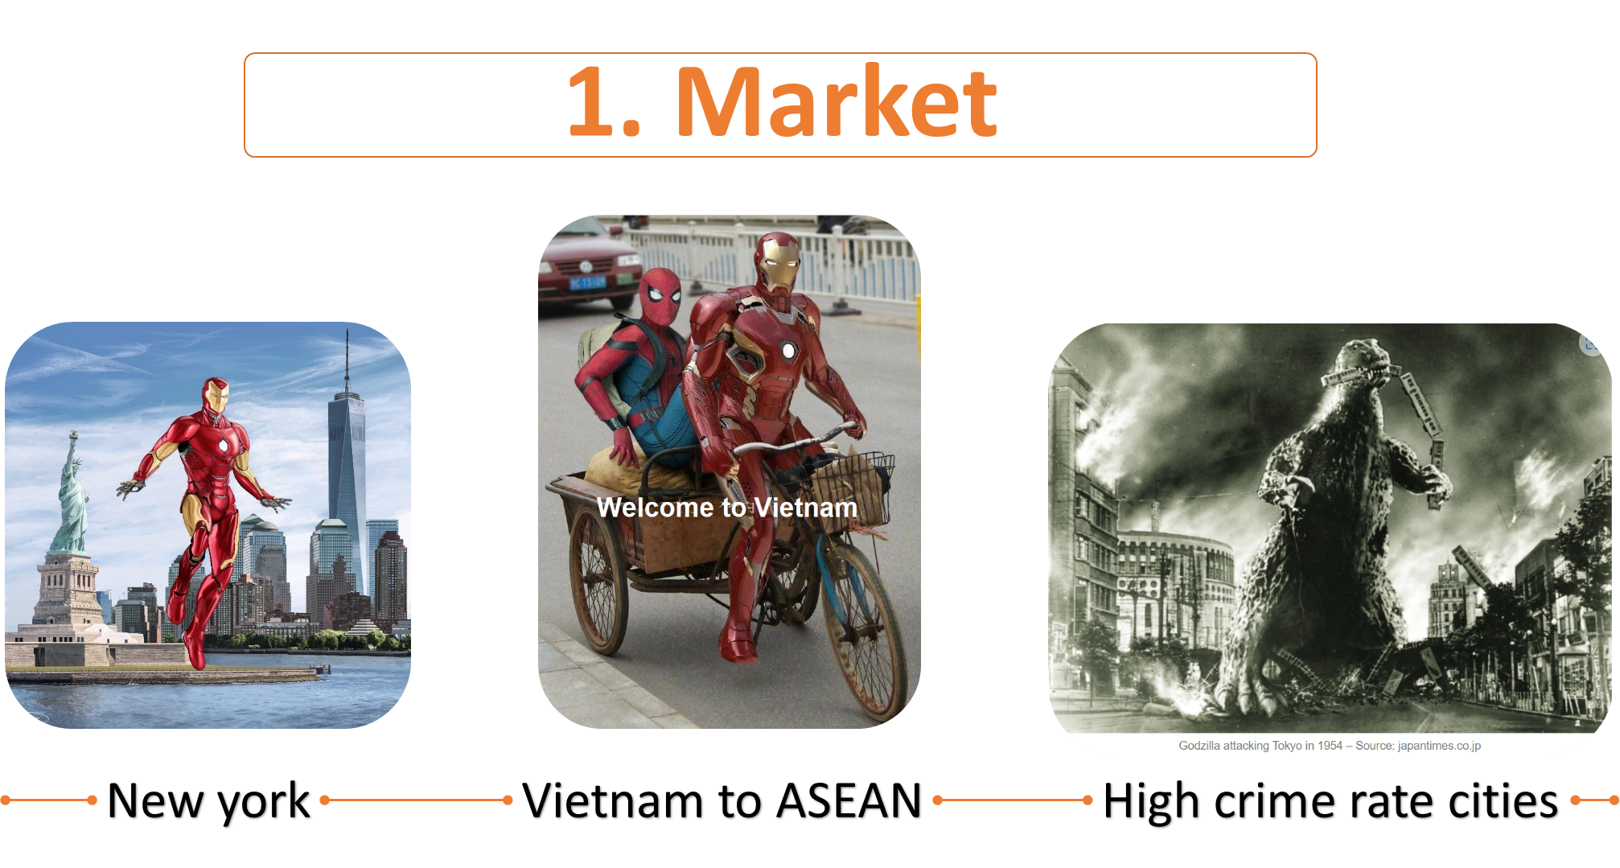

Slide 13
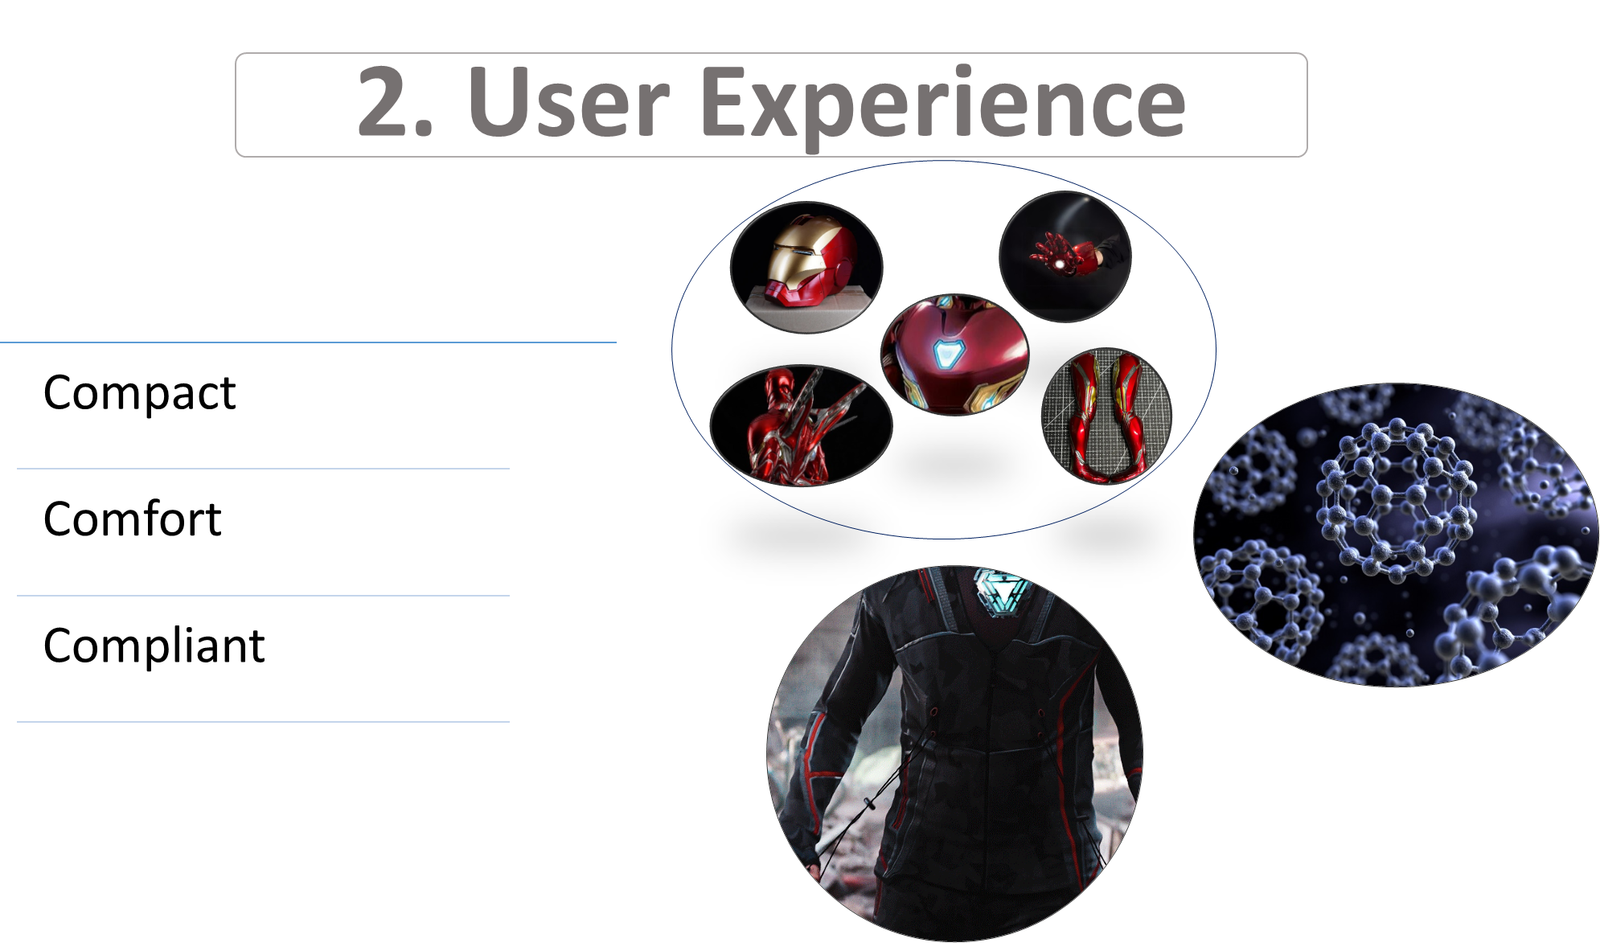

Slide 14
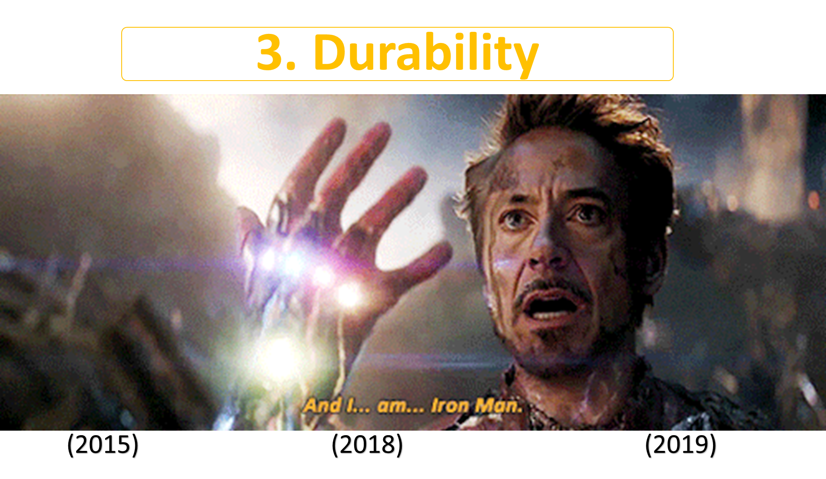

Slide 15
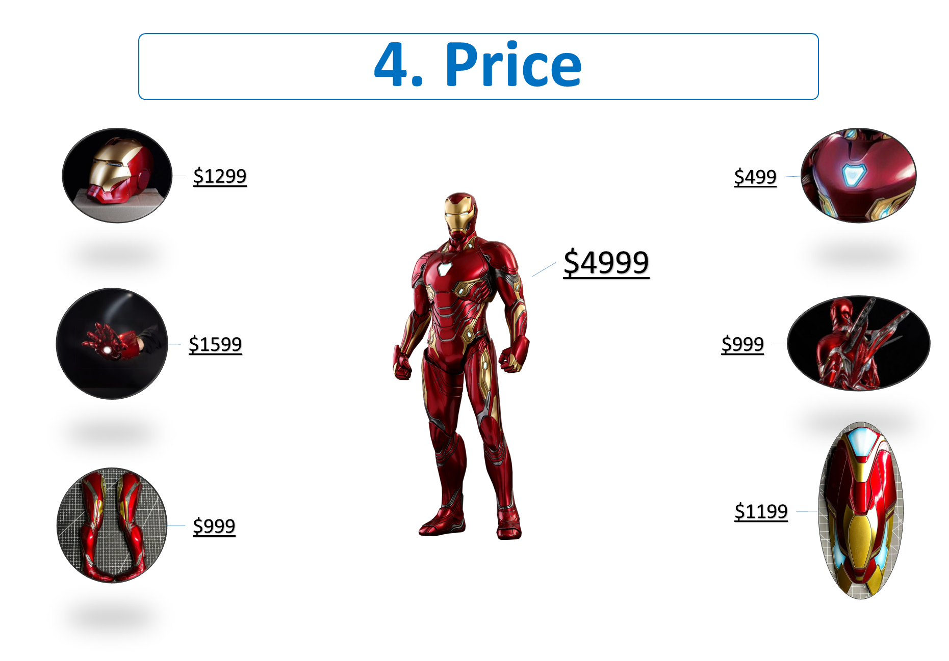

Slide 16


